Slide 1
Big Data – Amazon Web Services Week 10
Professor Arturo Castellanos, PhD
Assistant Professor – William & Mary
Big Data - MSBA

Slide 2

Agenda
- Create EC2 Instance
- Fix Spark
=> Add the Spark files into c:\spark
=> Add the Winutils files into your SPARK_HOME\bin
=> Modify the environment variables
==> JAVA_HOME
==> SPARK_HOME
==> Add bin folders to Path
- Hands-on: Spark transformations and actions
- Hands-on: Titanic Spark DataFrame. Spark SQL titanic exercise --pause video.
- Group project: Alpha example, twitter topic analysis.

Slide 3
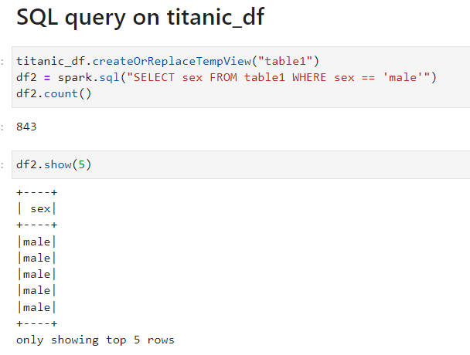
Executing SQL Queries
The SparkSession provides a method called sql which can be used to execute a SQL query.
The sql method takes a SQL statement as an argument and returns a DataFrame representing the result of the given query.
Unfortunately, SQL queries cannot be run directly against a DataFrame. To issue SQL queries against an existing DataFrame we can leverage the createOrReplaceTempView function to build a temporary table
After creating the temporary table, we can simply use the sql method, which allows us to write SQL code to manipulate data within a DataFrame.

Slide 4
Executing SQL Queries
The SparkSession provides a method called sql which can be used to execute a SQL query.
The sql method takes a SQL statement as an argument and returns a DataFrame representing the result of the given query.
Unfortunately, SQL queries cannot be run directly against a DataFrame. To issue SQL queries against an existing DataFrame we can leverage the createOrReplaceTempView function to build a temporary table
After creating the temporary table, we can simply use the sql method, which allows us to write SQL code to manipulate data within a DataFrame.

Slide 5
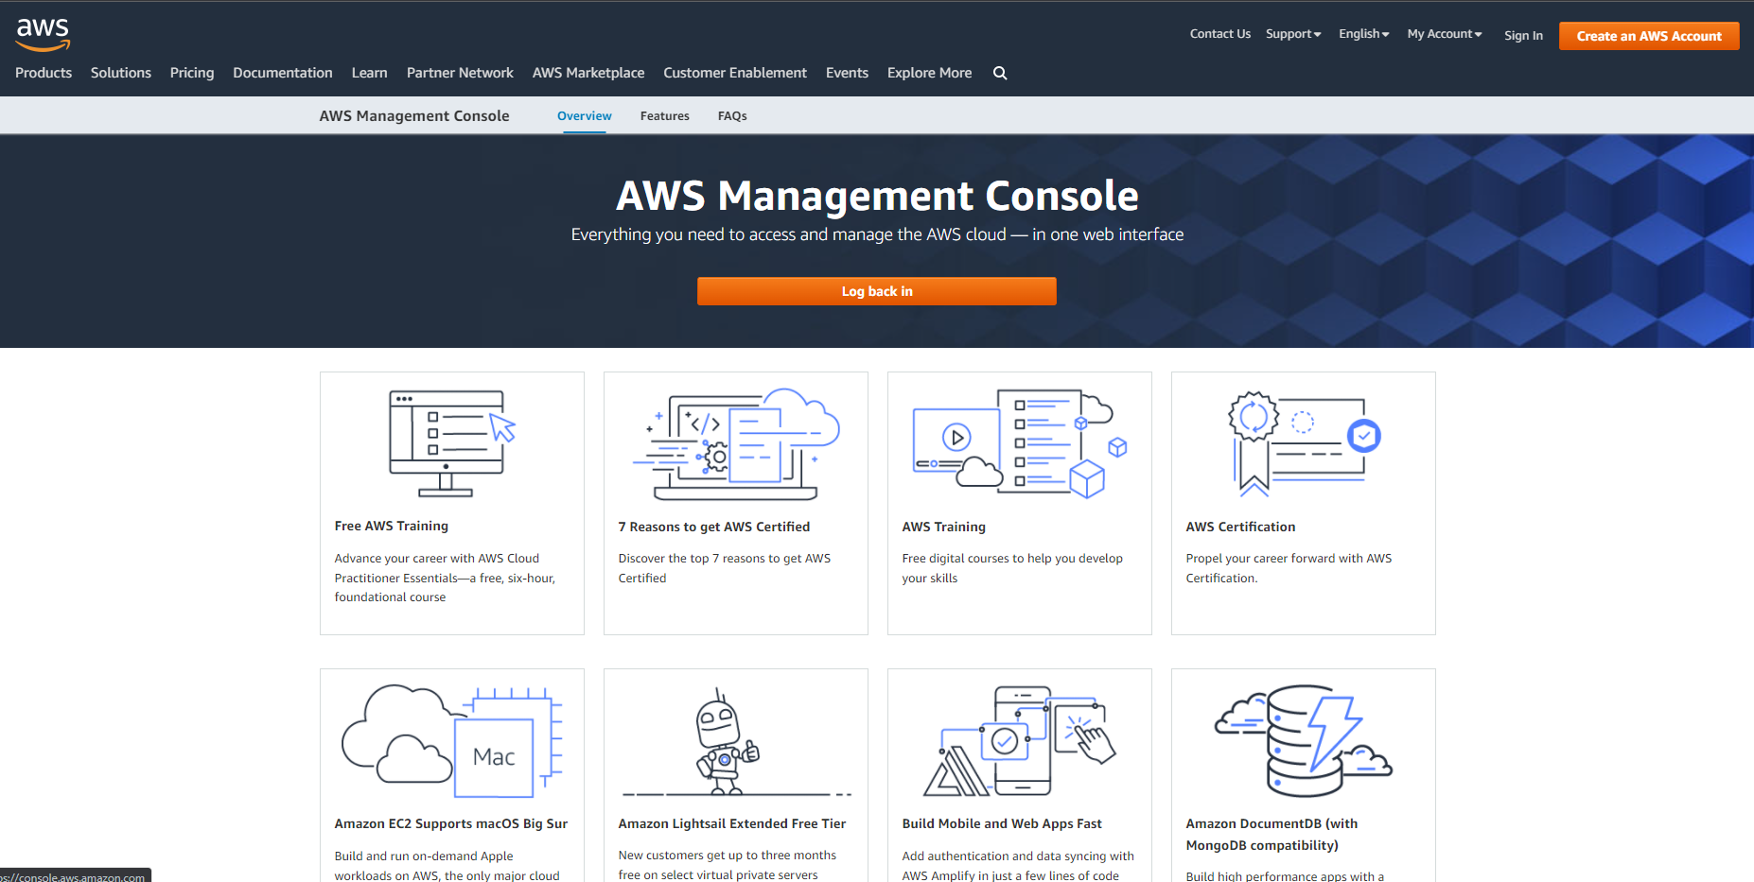
aws.amazon.com

Slide 6
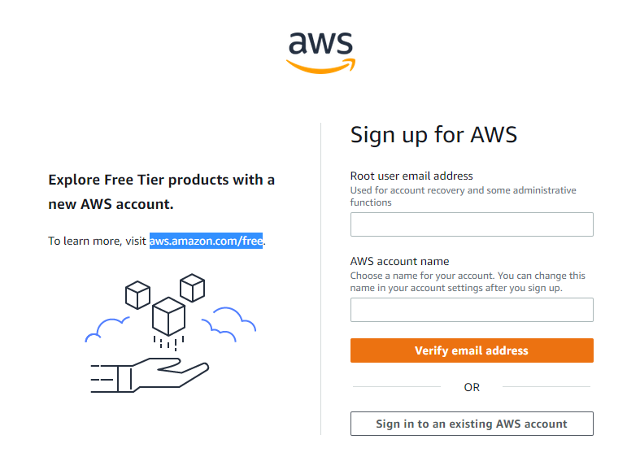

Slide 7
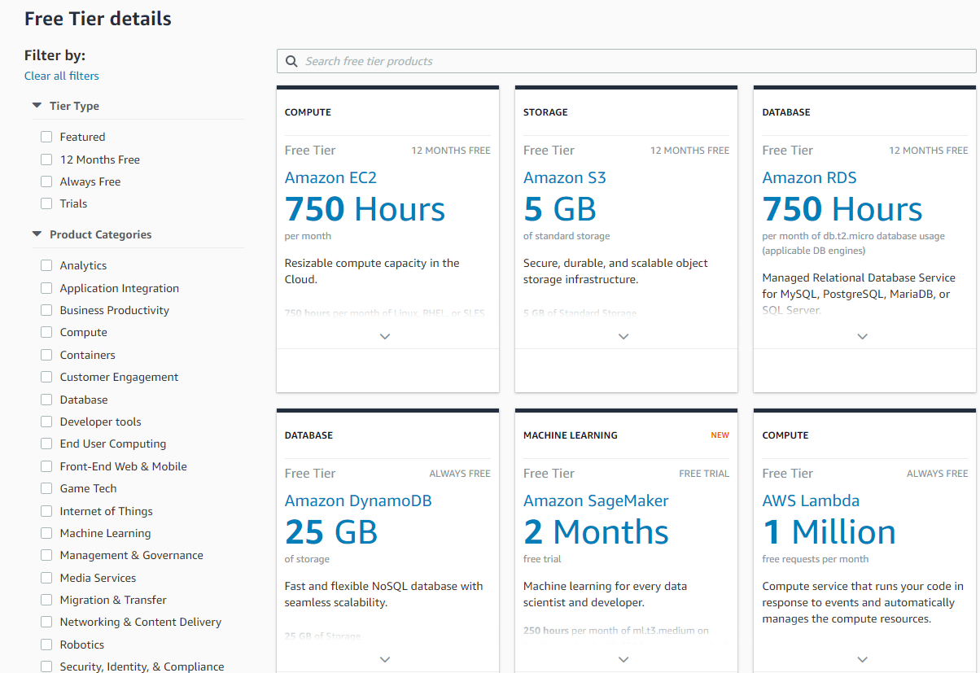

Slide 8
Agenda
Interacting with an API
Requesting a Key
Look at the documentation for endpoints
Use pandas to shape the data and select what you need
Working with AWS S3 (Simple Storage Service)
Getting your keys
Creating a bucket in S3
Listing the buckets in S3
Saving data into S3
Retrieving data from S3

Slide 9
Jupyter Notebook

Slide 10
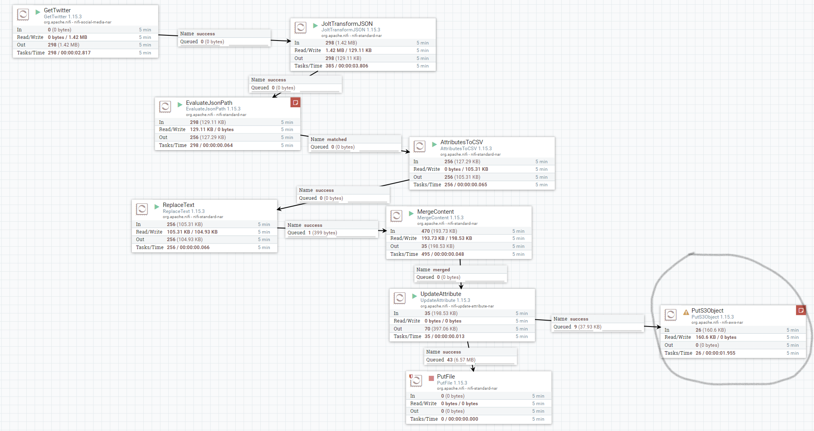
Nifi

Slide 11
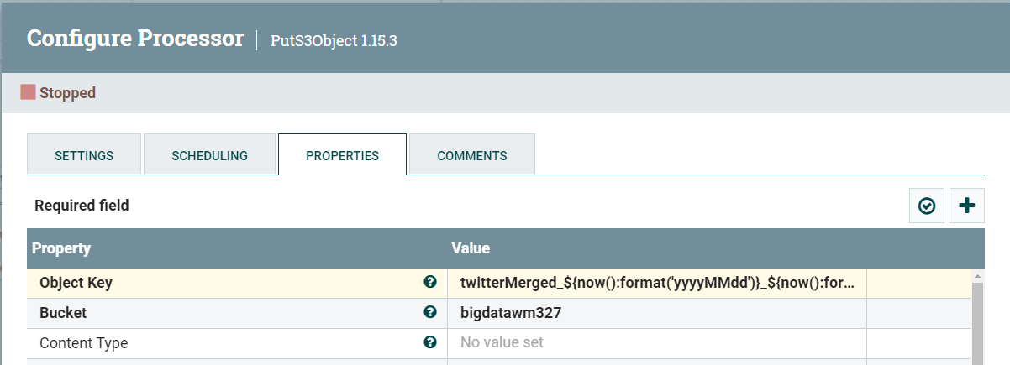
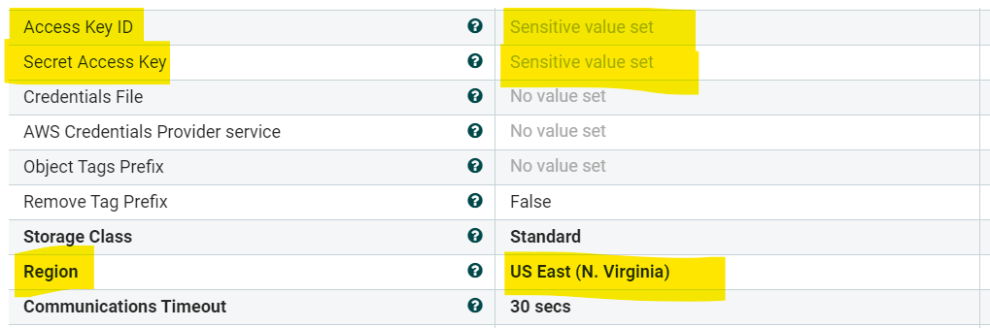
PutS3Object

